Slide 1
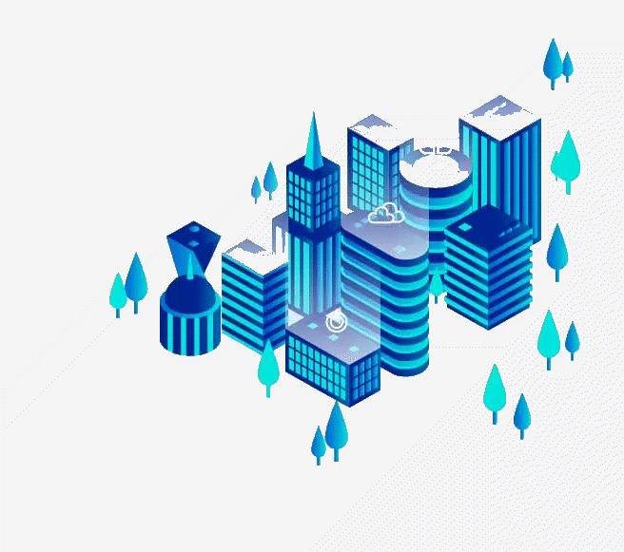
Edge Computing
Guided By: Prof. Remya R S, HOD, Dept Of CSE
Presented by: Abhiragh A R, MCC21CS005, S7 CSE

Slide 2
Abstract Literature Survey What ? Where ? Why ? Evolution Architecture Advantages
09 10 11 12 13 14 15
Contents
01 02 03 04 05 06 07
08
Edge Fundamentals Enabling Technologies Applications Limitations Future Conclusion References
01

Slide 3
Abstract
Increasing QoS constraints like latency, bandwidth, and jitter, along with the growing number of IoT devices, are causing significant core network congestion. Edge Computing (EC) reduces network congestion and latency by processing and caching data at the network's edge. Exploring EC from foundational concepts to its evolution from CDNs to Multi-Access Edge Computing, covering key aspects such as resource management, computation offloading, data management, and enabling technologies like Edge Intelligence, 5G and Containerization. Also discussing Edge Computing use cases, including smart cities, e-Health, and military applications, and future considerations regarding green energy and standardization.
02

Slide 4
Literature Survey
Serial No | Title | Author | Summary
1. | Edge Intelligence: Empowering Intelligence to the Edge of Network | D. Xu, T. Li, Y. Li, X. Su, S. Tarkoma, T. Jiang, J. Crowcroft, P. Hui | This paper discusses the concept of Edge Intelligence, which integrates AI capabilities at the edge of the network and empowering edge devices with intelligence to enhance data processing efficiency, reduce latency, in real-time applications.
2. | Resource Scheduling in Edge Computing: A Survey | Q. Luo, S. Hu, C. Li, G. Li, W. Shi | This provides a comprehensive overview of resource scheduling techniques in Edge Computing. It categorizes existing scheduling strategies and discusses their effectiveness in managing resources across diverse edge environments.
03

Slide 5
Literature Survey
Serial No | Title | Author | Summary
3. | Edge-Computing-Enabled Smart Cities: A Comprehensive Survey | L. U. Khan, I. Yaqoob, N. H. Tran, S. M. A. Kazmi, T. N. Dang, C. S. Hong | This paper surveys the role of Edge Computing in the development of smart cities. It examines how edge technologies can enhance urban services by enabling real-time data processing and analytics.
4. | An Overview on Edge Computing Research | K. Cao, Y. Liu, G. Meng, Q. Sun | This overview highlights the current state of research in Edge Computing, covering its definitions, architectures, and key technologies. The authors provide insights into the evolution of EC and its applications across different domains.
04

Slide 6
Literature Survey
Serial No | Title | Author | Summary
5. | Edge-Computing Architectures for Internet of Things Applications: A Survey | S. Hamdan, M. Ayyash, S. Almajali | This survey focuses on various edge-computing architectures specifically designed for IoT applications and analyze different architectural models and their suitability for IoT environments.
6. | A Comprehensive Survey on Mobile Edge Computing: Challenges, Tools, Applications | F. Vhora, J. Gandhi | This paper provides an extensive survey of Mobile Edge Computing (MEC), examining its challenges, tools, and applications. The authors discuss the benefits of MEC in reducing latency and enhancing user experience in mobile networks.
05

Slide 7
What is Edge Computing ?
Edge Computing (EC) is an innovative computing paradigm that addresses the challenges posed by the growing number of connected devices and the demand for low-latency, high-bandwidth applications.
By processing and caching data at the network's edge, EC significantly reduces latency and improves performance for applications such as autonomous vehicles, smart cities, and e-Health.
06

Slide 8
Where is the Edge ?
As a term, the word ‘‘Edge’’ signifies the extreme part of any given network. In the in the case of the data network (the Internet), the Edge or, more precisely, the Edge Device (ED) is any extreme end-users or IoT device (mobile phones, cars, smartwatches, etc.).
However ,In EC, the devices responsible for executing computation tasks are referred to as Edge Servers (ESs) or Edge nodes (ENs). Those computing devices can exist in one hope or a few more from the edge devices.
07

Slide 9
Why Edge Computing ?
Edge Computing significantly improves QoS by reducing latency and increasing bandwidth.
Local Data Processing conserves bandwidth and enables responses to be received much faster.
Also ensures that sensitive data can be handled with greater privacy, addressing concerns about sending data to centralized cloud servers.
08

Slide 10
Evolution of Edge Computing
content delivery networks
multi access edge computing
fog computing
cloudlets
mobile edge computing
09

Slide 11
Evolution of Edge Computing
Content Delivery Networks
CDNs are systems of distributed servers that deliver web content to users based on their geographic location.
multi access edge computing
fog computing
cloudlets
mobile edge computing
10

Slide 12
Evolution of Edge Computing
Content Delivery Networks
CDNs are systems of distributed servers that deliver web content to users based on their geographic location.
multi access edge computing
fog computing
Cloudlets Cloudlets are small-scale data centers that provide cloud computing capabilities at the edge of the network.
mobile edge computing
11

Slide 13
Evolution of Edge Computing
Content Delivery Networks
CDNs are systems of distributed servers that deliver web content to users based on their geographic location.
Fog Computing
A decentralized computing system that extends cloud computing to the edge of a network.
multi access edge computing
Cloudlets Cloudlets are small-scale data centers that provide cloud computing capabilities at the edge of the network.
mobile edge computing
12

Slide 14
Evolution of Edge Computing
Content Delivery Networks
CDNs are systems of distributed servers that deliver web content to users based on their geographic location.
Fog Computing
A decentralized computing system that extends cloud computing to the edge of a network.
multi access edge computing
Cloudlets Cloudlets are small-scale data centers that provide cloud computing capabilities at the edge of the network.
Mobile edge computing
MEC is a network architecture that brings computation and storage resources closer to mobile users.
13

Slide 15
Evolution of Edge Computing
Content Delivery Networks
CDNs are systems of distributed servers that deliver web content to users based on their geographic location.
Fog Computing
A decentralized computing system that extends cloud computing to the edge of a network.
Multi Access Edge Computing
An evolution of mobile edge computing that allows multiple access technologies to leverage edge computing resources.
Cloudlets Cloudlets are small-scale data centers that provide cloud computing capabilities at the edge of the network.
Mobile edge computing
MEC is a network architecture that brings computation and storage resources closer to mobile users.
14

Slide 16
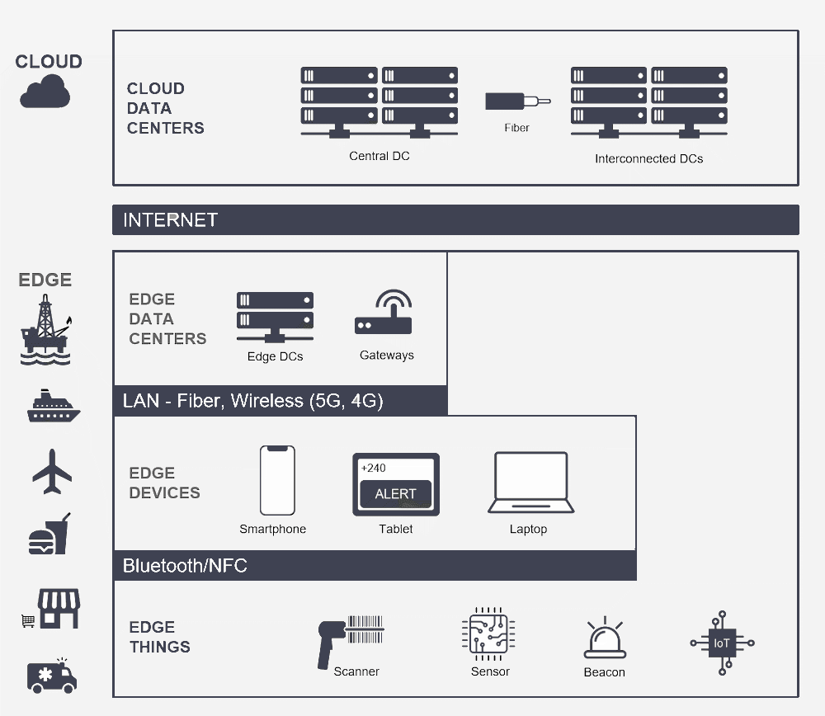
Edge Computing Architecture
15

Slide 17
Advantages of Edge
Real-Time Processing: Edge Computing allows for immediate data analysis and decision-making, which is crucial for applications where delays can have significant consequences.
Scalability for IoT Devices: With the increasing number of IoT devices, Edge Computing provides a scalable solution that can handle local data processing without overwhelming central cloud resources.
Improved Reliability: Edge Computing can continue to function even when connectivity to the central cloud is limited or disrupted, ensuring that critical applications remain operational in various environments.
16

Slide 18
Edge Fundamentals
Resource Management
Computation Offloading
Data Management
Network Management
17

Slide 19
Edge Fundamentals
Resource Management
Resource management in Edge Computing involves efficiently allocating and scheduling computing resources at the edge of the network.
Dynamic resource allocation algorithms, such as the Resource Allocation for Cloud and Edge (RACE) algorithm, help in efficiently assigning resources based on real-time demand.
It includes techniques for load balancing across edge nodes to prevent any single node from becoming a bottleneck.
18

Slide 20
Edge Fundamentals
Computation Offloading
Computation offloading refers to the practice of transferring processing tasks from resource-constrained devices to more powerful edge servers..
By offloading computation tasks closer to the data source, EC reduces latency, allowing for faster data processing.
Offloading tasks to edge servers can also conserve battery life on mobile devices
19

Slide 21
Edge Fundamentals
Data Management
Data management in Edge Computing focuses on processing and storing data at the edge of the network to minimize latency and bandwidth.
It includes strategies for caching frequently accessed data at the edge, allowing for quicker retrieval and reducing the need for repeated data transmission over the network.
20

Slide 22
Edge Fundamentals
Network Management
Network management encompasses the optimization of connectivity and communication between edge devices and servers.
It can dynamically allocate bandwidth and resources based on real-time demand, ensuring that critical applications maintain performance even during peak usage.
21

Slide 23
Enabling Technologies
A technology enabler is a technological advancement or innovation that facilitates the implementation and enhancement of specific applications, systems, or processes. It serves as a foundational element that allows organizations to leverage new capabilities and improve efficiency, performance, or functionality.
Edge Intelligence
5G
Containerization
22

Slide 24
Enabling Technologies
Edge Intelligence
Edge Intelligence integrates artificial intelligence (AI) capabilities directly into edge devices and nodes, allowing for real-time data processing and decision-making at the edge of the network.
This technology enhances the ability of edge devices to analyze data locally, reducing the need to send data to centralized cloud servers for processing.
23

Slide 25
Enabling Technologies
5G
The fifth generation of mobile network technology that provides significantly higher data rates, lower latency, and improved connectivity compared to previous generations. It supports a vast number of connected devices and enables new applications that require real-time communication and high bandwidth enabling Edge Computing to handle the increasing data generated by these devices efficiently.
24

Slide 26
Enabling Technologies
Containerization
Containerization is a lightweight virtualization technology that allows applications to run in isolated environments called containers. This approach enables developers to package applications and their dependencies together, ensuring consistent deployment across different environments, including edge nodes.
25

Slide 27
Applications of Edge
Smart Cities: Edge Computing enables real-time data processing and analytics for urban infrastructure, improving services like traffic management, waste management, and public safety.
Health: In healthcare, Edge Computing supports real-time data analysis from medical devices, enhancing patient care and response times.
Autonomous Vehicles: Edge Computing processes data from sensors and cameras in real-time, allowing for quick decision-making and improved safety in self-driving cars.
26

Slide 28
Applications of Edge
Industrial IoT: In manufacturing, Edge Computing facilitates real-time monitoring of equipment, and automation of processes, leading to increased efficiency and reduced downtime.
Military Applications: Edge Computing supports mission-critical operations by enabling real-time data processing and analytics from various sensors and devices in the field.
Augmented and Virtual Reality (AR/VR): Edge Computing enhances AR and VR experiences by reducing latency and providing real-time data processing, which is essential for immersive applications.
27

Slide 29
Applications of Edge
Smart Agriculture: Edge Computing enables precision farming by processing data from IoT sensors in real-time, optimizing resource usage, and improving crop yields.
Content Delivery and Streaming: Edge Computing improves the delivery of content by caching data closer to users, resulting in faster load times and reduced buffering for streaming services
28

Slide 30
Limitations of Edge
Standardization: The lack of standardization in Edge Computing can lead to interoperability issues between different edge devices and platforms.
Resource Constraints: Edge devices typically have limited computational power, storage, and energy resources compared to centralized cloud servers.
Management: Coordinating and managing resources across a large number of distributed edge nodes is a complex task.
29

Slide 31
Limitations of Edge
Energy Efficiency: Developing energy-efficient edge computing solutions is crucial to minimize the environmental impact and operating costs.
Heterogeneity: The wide range of edge devices, operating systems, and hardware architectures can make it challenging to develop and deploy edge applications.
30

Slide 32
Future of Edge
Increased Data Processing at the Edge: As the number of connected devices continues to rise, it is projected that a significant portion of data—up to 75%—will be processed at the edge by 2025.
Integration with 5G and IoT: Edge Computing and 5G technology will enhance connectivity and enable new applications that demand high bandwidth and low latency.
31

Slide 33
Future of Edge
Adoption of Edge Intelligence: The use of AI and ML at the edge will enable real-time decision-making and allowing devices to process data locally, reducing the reliance on cloud, thereby improving efficiency and privacy.
Standardization: The future of Edge Computing will need to involve efforts to establish standards and protocols that ensure inter-operability among various edge devices and platforms.
32

Slide 34
Conclusion
This seminar explored what Edge Computing is and how it revolutionizes data processing by bringing computation closer to users, thereby addressing the increasing demands for low latency and high bandwidth in various applications. Thus reducing network congestion and enhances the performance of critical services.
The technologies such as EI, 5G, and containerization and how it has enabled Edge Computing. As the field continues to evolve, addressing challenges related to standardization and sustainability
Ultimately, the future of Edge Computing promises to unlock new opportunities for innovation and efficiency, making it a vital component in the landscape of next-generation computing technologies.
33

Slide 35
References
[1] C. Jiang, Y. Qiu, H. Gao, T. Fan, K. Li, and J. Wan,: ‘‘An edge computing platform for intelligent operational monitoring in internet data centers,’’
[2] N. Apolonia, F. Freitag, L. Navarro, S. Girdzijauskas, and V. Vlassov: ‘‘Gossip-based service monitoring platform for wireless edge cloud computing,’’ in Proc. IEEE 14th Int. Conf. Netw., Sens. Control (ICNSC),
[3] R. M. Abid, T. Benbrahim, and S. Biaz: ‘‘IEEE 802.11s wireless mesh networks for last-mile internet access: An open-source real-world indoor testbed implementation,’’
[4] J. Liu, K. Luo, Z. Zhou, and X. Chen, ‘‘ERP: Edge resource pooling for data stream mobile computing,’’
[5] Y. Zheng, W. Xia, L. Jiang, F. Yan, and L. Shen, ‘‘Distributed multiagent cooperative resource sharing algorithm in fog networks,’’
[6] Y. Zhang, X. Lan, J. Ren, and L. Cai, ‘‘Efficient computing resource sharing for mobile edge-cloud computing networks,’’
[7] C. Tang, S. Xia, Q. Li, W. Chen, and W. Fang, ‘‘Resource pooling in vehicular fog computing,’’
34

Slide 36
References
[8] V. Karagiannis, N. Desai, S. Schulte, and S. Punnekkat, ‘‘Addressing the node discovery problem in fog computing,’’
[9] U. Polit, ‘‘Mobility-aware mechanisms for fog node discovery and selection,’’
[10] I. Murturi and S. Dustdar, ‘‘A decentralized approach for resource discovery using metadata replication in edge networks,’’.
[11] C. Jiang, X. Cheng, H. Gao, X. Zhou, and J. Wan, ‘‘Toward computation offloading in edge computing: A survey,’’
[12] Z. Liao, J. Peng, B. Xiong, and J. Huang, ‘‘Adaptive offloading in mobileedge computing for ultra-dense cellular networks based on genetic algorithm,’’
[13] X. Wang, J. Ye, and J. C. S. Lui, ‘‘Joint D2D collaboration and task offloading for edge computing: A mean field graph approach,’’
[14] I. Kovacevic, E. Harjula, S. Glisic, B. Lorenzo, and M. Ylianttila, ‘‘Cloud and edge computation offloading for latency limited services,’’
35

Slide 37


